Slide 1
Software Requirement Specification
Project on : Pharmacy Management System
Prepared by
Md. Shahariar Hossen
Id : 1247166
Round- 39

Slide 2
Story
Shetu Has a Pharmacy. He has two employees and lots of drugs. He Buy drugs from the Company. He Adds the drug details of the drugs in his shop. He wants to know how much he sells per day, and his employees sell per day. He Also want to maintain a database of the clients.
He wants a Software that can do all of his works.

Slide 3
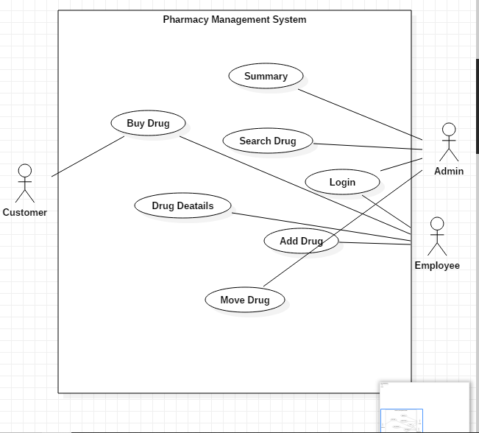
Use Case

Slide 4
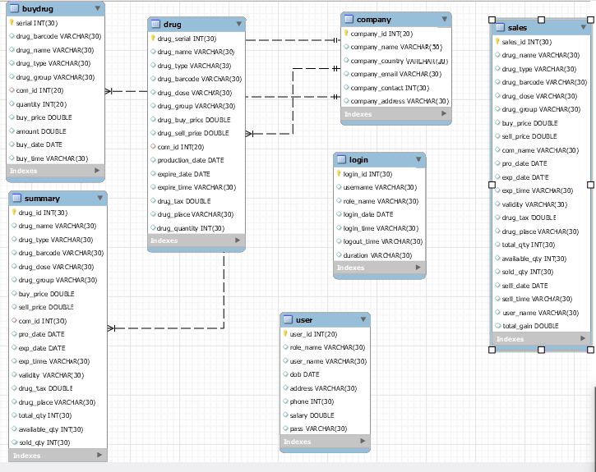
Class Diagram

Slide 5
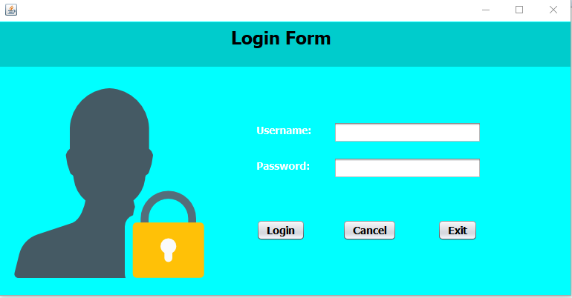
Log in Page

Slide 6
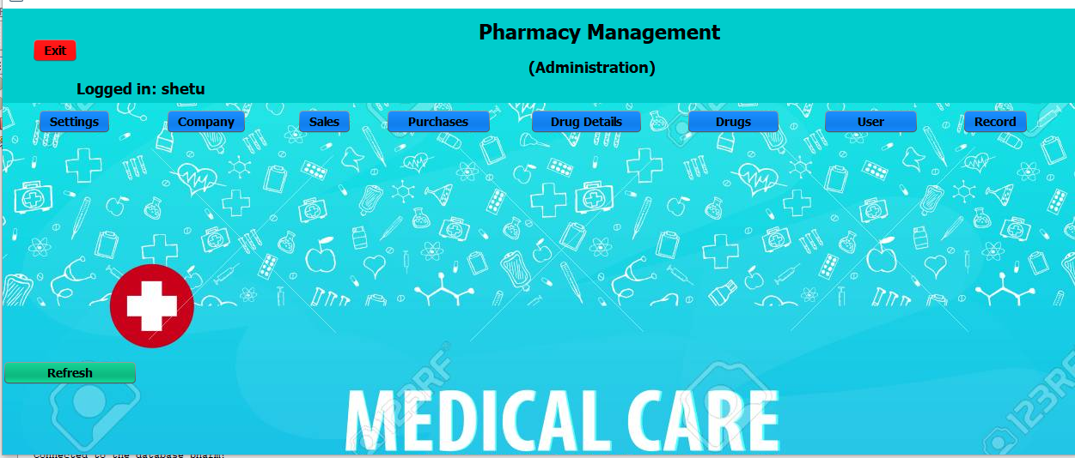
Administrator Dashboard

Slide 7
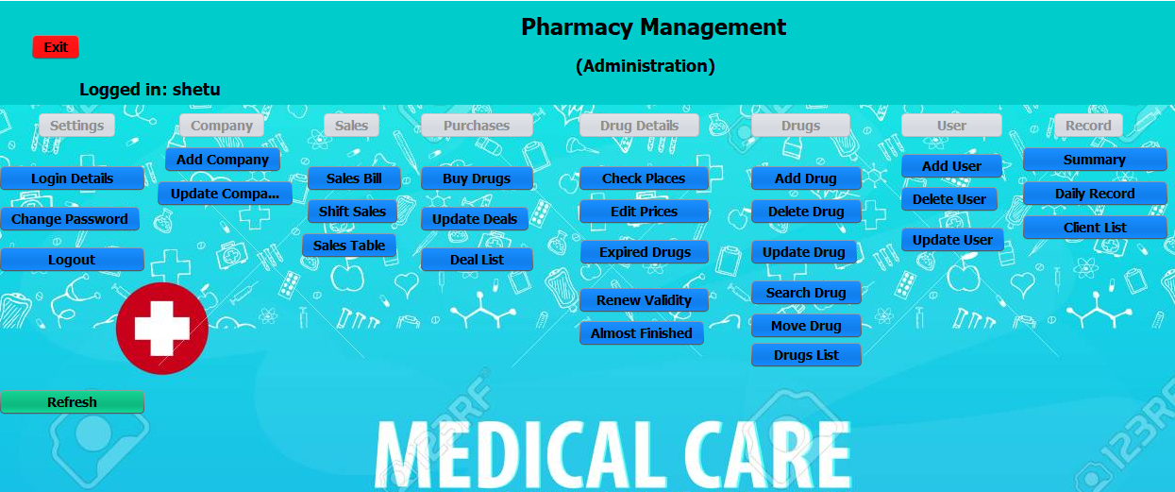

Slide 8
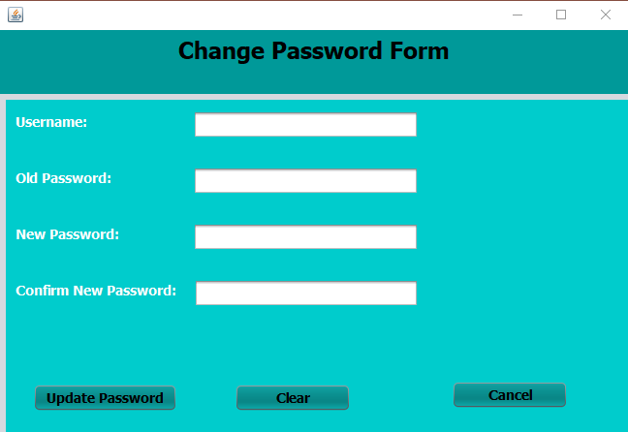

Slide 9
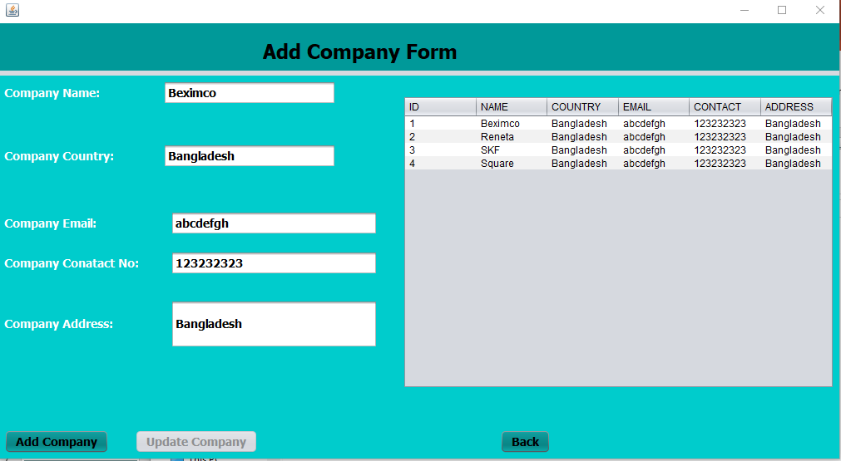

Slide 10
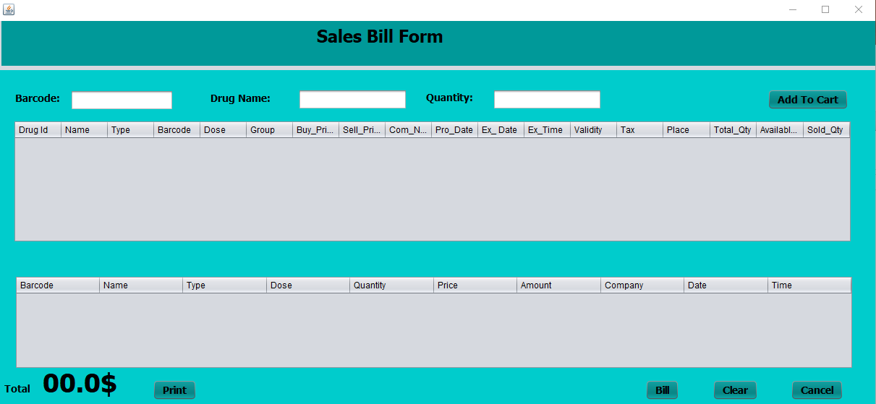

Slide 11
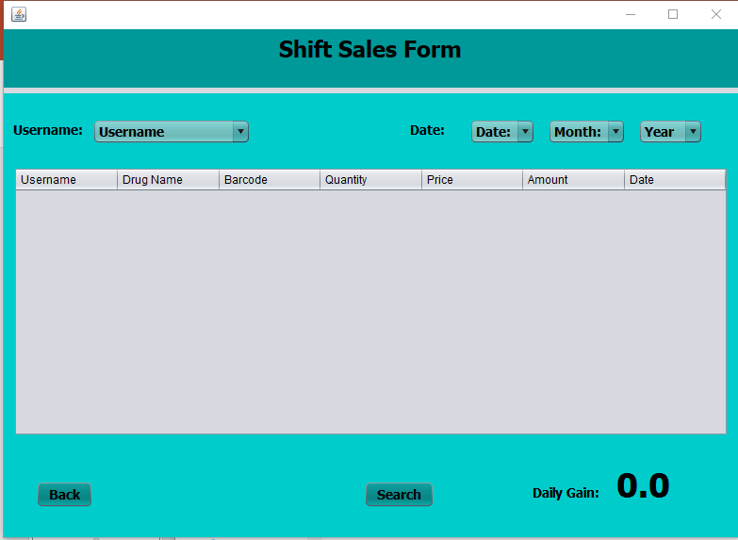
Author Information

Slide 12
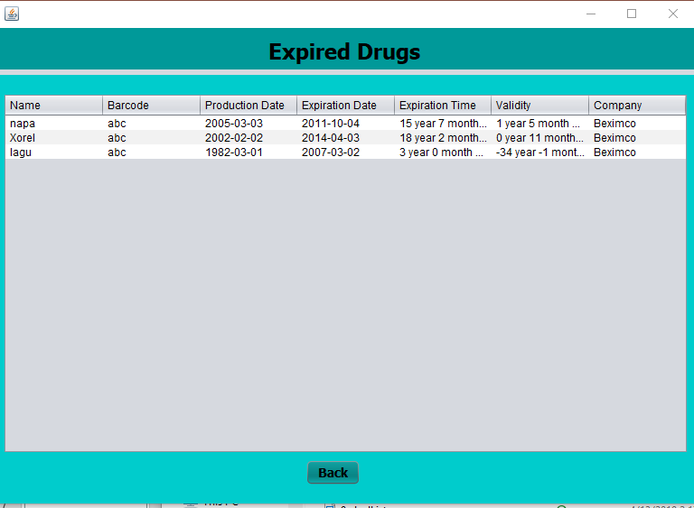
Thank You Sir

Slide 13
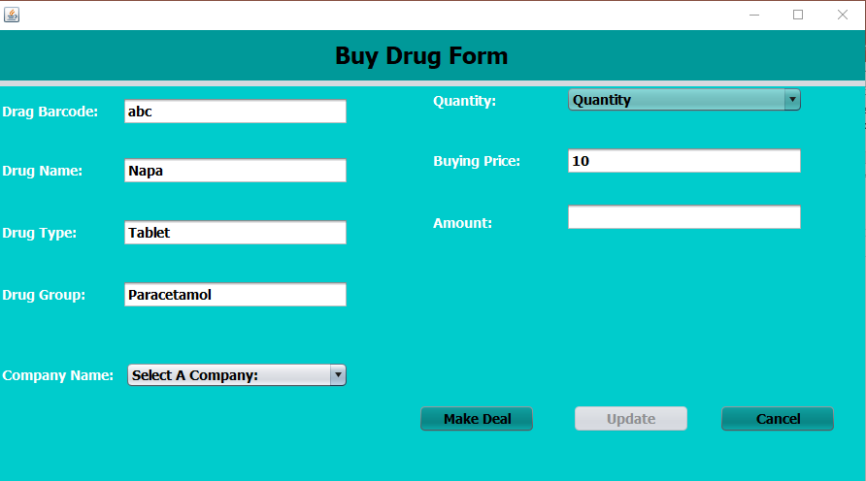

Slide 14
